Slide 1

COMPUTER INFORMATION

Slide 2
Hardware and Software

Slide 3
Hardware and Software
A program is a sequence of instructions that perform a particular task. A set of programs form a software.
It is the software which gives hardware its capability.
Hardware is of no use without software and software cannot be used without hardware.

Slide 4
Types of Software
Software can be broadly are categorized as:
System Software
Application Software
Utility Software

Slide 5
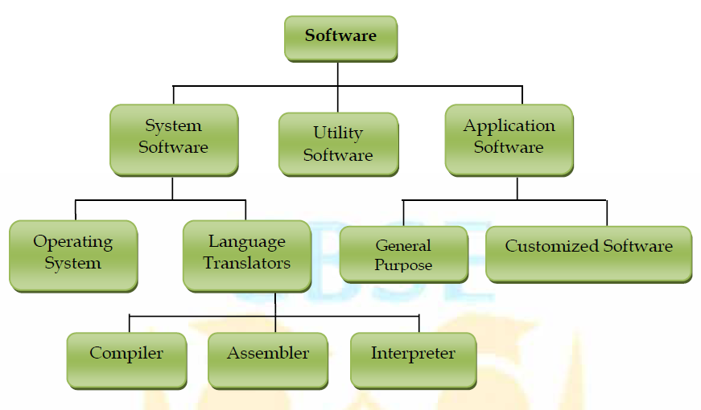
Types of Software

Slide 6
System Software
System Software is the software that is directly related to coordinating computer operations and performs tasks associated with controlling and utilizing computer hardware. These programs assist in running application programs and are designed to control the operation of a computer system.

Slide 7
System Software
System software directs the computer what to do, when to do and how to do. System software can be further categorized into:-
Operating System
Language Translators

Slide 8
Operating System
An Operating system is the most important system software.
It is a set of programs that control and supervise the hardware of a computer and also provide services to application software, programmers and users. Ex :-

Slide 9
Operating System
Some of the popular operating systems used in personal computers are DOS, Windows, Unix, Linux, Solaris, etc.

Slide 10
MEMORY CONCEPTS

Slide 11
Memory
Memory is one of the most important components of a computer system as it stores data and instructions.
Every memory chip contains thousands of memory locations. In the computer, the data is stored in the form of bits and bytes.

Slide 12
Memory
A bit is the smallest storage unit of memory. A nibble is a collection of 4 bits. Eight bits combined together to form a single byte, which in turn represents a single character

Slide 13
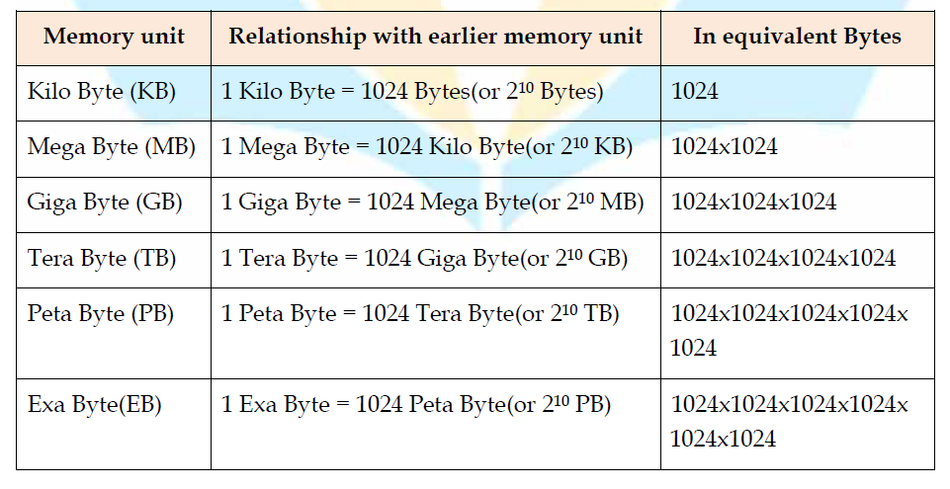
Memory Units

Slide 14
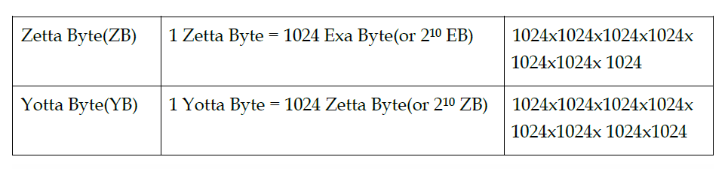
Memory Units

Slide 15
Types of Memories
The computer memories can be divided into following categories:
Primary Memory
Cache Memory
Secondary memory

Slide 16
Thank you
Have a good day
By :- Rohit

